Slide 1
Lesson 2 - Indexing Into an Array
Mr Mack 2019

Slide 2
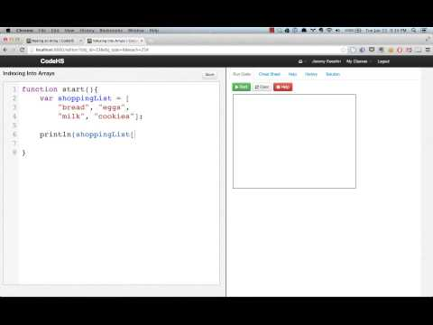
Indexing Into an Array

Slide 3
What is the index of the very first item in an array?
0
1

Slide 4
var shoppingList = ["milk", "eggs", "sugar", "bread", "cake"];
Which line of code will correctly change "cake" to "apples"?
shoppingList["cake"] = "apples";
shoppingList["apples"] = "cake";
shoppingList[4] = "apples";
shoppingList[5] = "apples";

Slide 5
Example: Array Indexing Practice
This is an example for this lesson. You are encouraged to play around with it, run and change the code, and learn how it works. When you are done, click continue to go to the next problem.

Slide 6
Exercise 5.2.1: Top Websites
Create an array of your favorite 4 websites. Print out the 0th element in the array. Now set the 0th element to be “google.com” and try printing it out again.

Slide 7
Adding/Removing From an Array

Slide 8
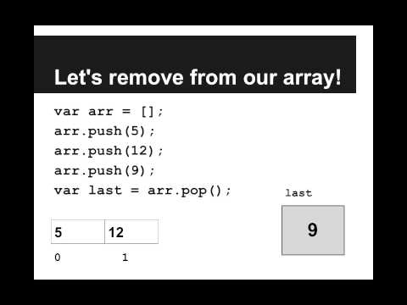

Slide 9
What index refers to the “end” of an array?
The lowest index, index 0
The highest index

Slide 10
var numbers = [0, 1, 2, 3, 4];
How can we add a 5 to the end of numbers?
numbers[5] = 5;
numbers[0] = 5
numbers.push(5);
numbers.pop(5);

Slide 11
Example: Add/Remove From Array
This is an example for this lesson. You are encouraged to play around with it, run and change the code, and learn how it works. When you are done, click continue to go to the next problem.

Slide 12
Exercise 5.2.2: Practice Push and Pop
Create an empty array. Now push on the first six letters of the alphabet. Print out each index individually. Now pop the last two elements.
Now print out the first six values again.

